Slide 1
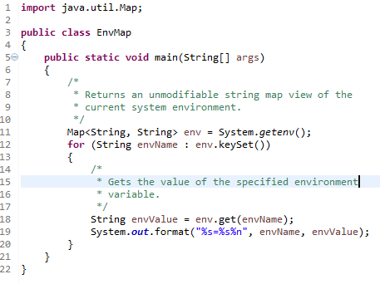
Environment Variables
Many operating systems use environment variables to pass configuration information to applications.
Like properties in the Java platform, environment variables are key/value pairs, where both the key and the value are strings.
The conventions for setting and using environment variables vary between operating systems, and also between command line interpreters.
To learn how to pass environment variables to applications on your system, refer to your system documentation.
There are many subtle differences between the way environment variables are implemented on different systems. For example, Windows ignores case in environment variable names, while UNIX does not. The way environment variables are used also varies. For example, Windows provides the user name in an environment variable called USERNAME, while UNIX implementations might provide the user name in USER, LOGNAME, or both.

